Slide 1
Assignment 1 numerical analysis
& Design
Submitted To : Shaligram Sir
Submitted By : Vinay Tare

Slide 2
Section : 1
Algorithms For Finding Roots Of Polynomial Equations

Slide 3
Bisection Method (Algorithm)
Algorithm:
1. Start
2. Decide initial values for x1 and x2 and stopping criterion, E.
3. Compute f1 = f(x1) and f2 = f(x2).
4. If f1 * f2>0, x1 and x2 do not bracket any root and go to step 8;
Otherwise continue.
5. Compute x0 = (x1+x2)/2 and compute f0 = f(x0)
6. If f1*f0 < 0 then
set x2 = x0
else
set x1 = x0
set f1 = f0
7. If absolute value of (x2 – x1)/x2 is less than error E, then
root = (x1 + x2)/2
write the value of root
go to step 8
Else,
go to step 4
8. Stop.

Slide 4
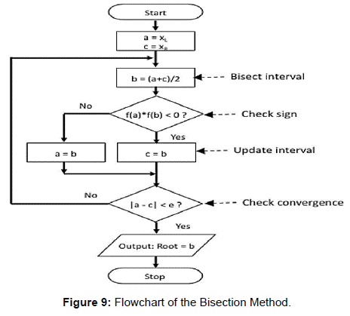
Bisection Method (Flowchart)

Slide 5
Regula-Falsi Method (Algorithm)
Algorithm:
Start
Read values of x0, x1 and e
#Here x0 and x1 are the two initial guesses ‘e’ is the degree of accuracy or the absolute error i.e. the stopping criteria#
Compute function values f(x0) and f(x1)
Check whether the product of f(x0) and f(x1) is negative or not.
If it is positive take another initial guesses.
If it is negative then goto step 5.
Determine:
x = [x0*f(x1) – x1*f(x0)] / (f(x1) – f(x0))
Check whether the product of f(x1) and f(x) is negative or not.
If it is negative, then assign x0 = x;
If it is positive, assign x1 = x;
Check whether the value of f(x) is greater than 0.00001 or not.
If yes, goto step 5.
If no, goto step 8.
#Here the value 0.00001 is the desired degree of accuracy, and hence the stopping criteria.#
Display the root as x.
Stop.

Slide 6
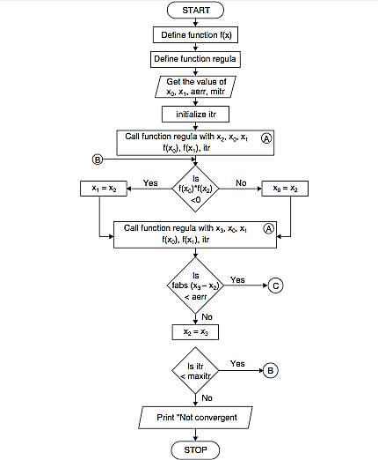
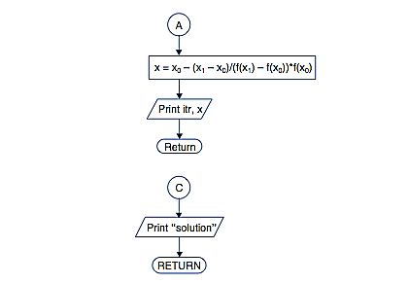
Regula-Falsi Method (Flowchart)

Slide 7
Secant Method (Algorithm)
Algorithm:
Start
Get values of x0, x1 and e
#Here x0 and x1 are the two initial guesses,
‘e’ is the stopping criteria, absolute error or the desired degree of accuracy#
3. Compute f(x0) and f(x1)
4. Compute x2 = [x0*f(x1) – x1*f(x0)] / [f(x1) – f(x0)]
5. Test for accuracy of x2
If |(x2 – x1)/x2|> e,
then assign x0 = x1 and x1 = x2
goto step 4
Else,
goto step 6
6. Display the required root as x2.
7. Stop.

Slide 8
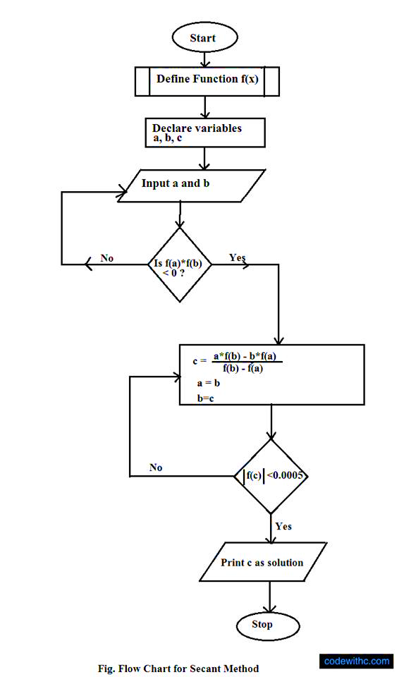
Secant Method (Flowchart)

Slide 9
Newton Raphson Method (Algorithm)
Algorithm:
Start
Read x, e, n, d
# ‘x’ is the initial guess,
‘e’ is the absolute error i.e the desired degree of accuracy,
‘n’ is for operating loop,
‘d’ is for checking slope*
Do for i =1 to n in step of 2
f = f(x)
f1 = f'(x)
If ( |f1| < d), then display too small slope and goto 11.
7. x1 = x – f/f1
8. If ( |(x1 – x)/x1| < e ), the display the root as x1 and goto 11.
9. x = x1 and end loop
10. Display method does not converge due to oscillation.
11. Stop.

Slide 10
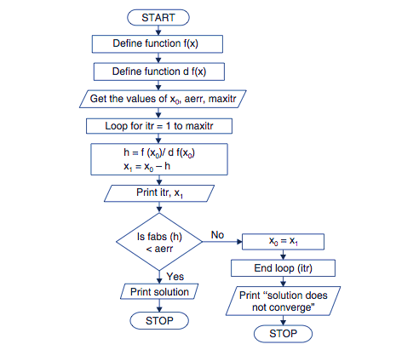
Newton Raphson Method (Flowchart)

Slide 11
Fixed Point Iteration Method (Algorithm)
Algorithm:
Start
Read values of x0 and e.
#Here x0 is the initial approximation,
‘e’ is the absolute error or the desired degree of accuracy, also the stopping criteria#
Calculate x1 = g(x0)
If |x1 – x0| <= e, goto step 6.
Else, assign x0 = x1 and goto step 3.
Display x1 as the root.
Stop.

Slide 12
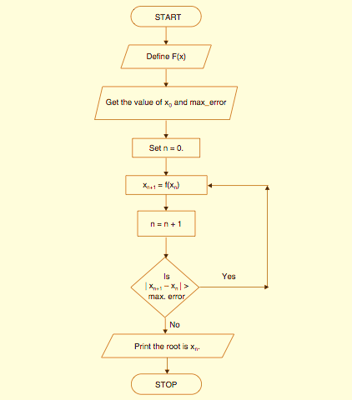
Fixed Point Iteration Method (Flowchart)

Slide 13
Section : 2
Algorithms For Applying Interpolation

Slide 14
Lagrange’s Interpolation Method (Algorithm)
Algorithm :
1. Start
2. Read number of data (n)
3. Read data Xi and Yi for i=1 to n
4. Read value of independent variables say xp
whose corresponding value of dependent say yp is to be determined.
5. Initialize: yp = 0
6. For i = 1 to n
Set p = 1
For j =1 to n
If i ≠ j then
Calculate p = p * (xp - Xj)/(Xi - Xj)
End If
Next j
Calculate yp = yp + p * Yi
Next i
7. Display value of yp as interpolated value.
8. Stop.

Slide 15
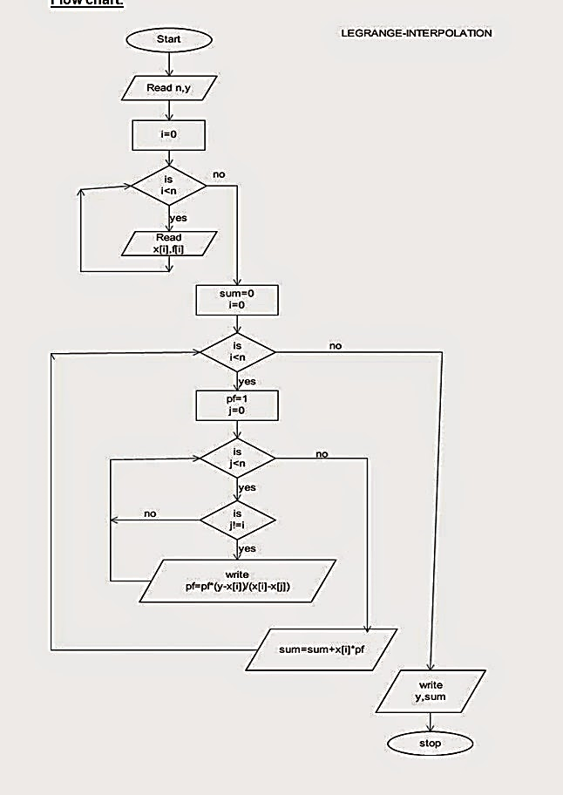
Lagrange’s Interpolation Method (Flowchart)

Slide 16
Section : 3
Algorithms For
Linear Equations

Slide 17
Gaussian Elimination Method (Algorithm)
Algorithm :
Start
Enter the no. of equations, n.
Create an nx(n+1) matrix, which will be the augmented matrix.
Create an array ‘x’ of size ‘n’ which will store the solutions.
Enter the elements of augmented matrix.
Pivoting :
For i=0 to n-1
For k=i+1 to n-1
If aii<aki , Then For j=0 to n
Swap aij with akj
Gaussian Elimination :
For k=i+1 to n-1
t = aki/aii
For j=0 to n-1
akj=akj-t*aij
Back-substitution :
For i=n-1 to 0
xi=ain
For j=0 to n-1
If j != i
Then xi=xi-aij*xj
xi=xi/aii
Print the solution i.e. the elements of x.
Stop.

Slide 18
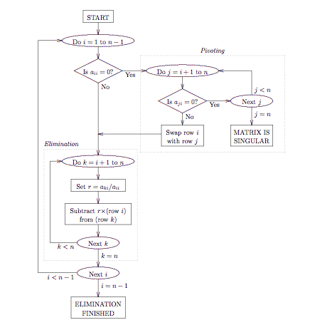
Gauss Elimination Method (Flowchart)

Slide 19
Gauss Jacobi Iteration Method (Algorithm)
Algorithm :
1. Start
2. Arrange given system of linear equations in
diagonally dominant form
3. Read tolerable error (e)
4. Convert the first equation in terms of first variable,
second equation in terms of second variable and so on.
5. Set initial guesses for x0, y0, z0 and so on
6. Substitute value of x0, y0, z0 ... from step 5 in
equation obtained in step 4 to calculate new values
x1, y1, z1 and so on
7. If| x0 - x1| > e and | y0 - y1| > e and | z0 - z1| > e
and so on then goto step 9
8. Set x0=x1, y0=y1, z0=z1 and so on and goto step 6
9. Print value of x1, y1, z1 and so on
10. Stop.

Slide 20
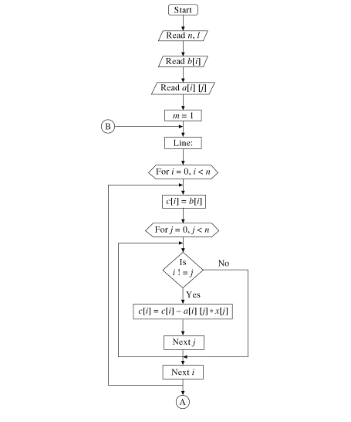
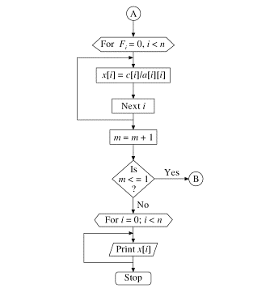
Gauss Jacobi Iteration Method (Flowchart)

Slide 21
Gauss Siedal Iteration Method (Algorithm)
Algorithm:
Start
Declare the variables and read the order of the matrix n
Read the stopping criteria er
Read the coefficients aim as
Do for i=1 to n
Do for j=1 to n
Read a[i][j]
Repeat for j
Repeat for i
Read the coefficients b[i] for i=1 to n
Initialize x0[i] = 0 for i=1 to n
Set key=0
For i=1 to n
Set sum = b[i]
For j=1 to n
If (j not equal to i)
Set sum = sum – a[i][j] * x0[j]
Repeat j
x[i] = sum/a[i][i]
If absolute value of ((x[i] – x0[i]) / x[i]) > er, then
Set key = 1
Set x0[i] = x[i]
Repeat i
If key = 1, then
Goto step 6,
Otherwise print results
Stop.

Slide 22
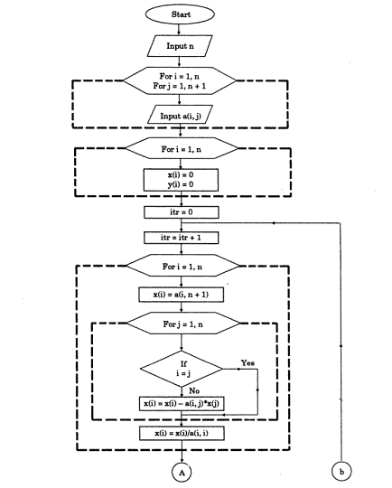
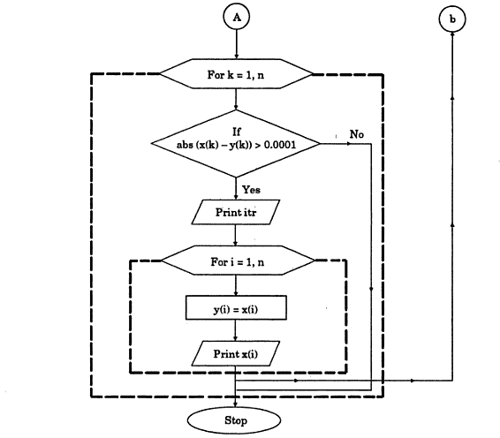
Gauss Siedal Method (Flowchart)

Slide 23
Section : 4
Algorithms For Ordinary Differential Equation

Slide 24
Euler Method (Algorithm)
Algorithm:
Start
Define function
Get the values of x0, y0, h and xn
#Here ‘x0’ and ‘y0’ are the initial conditions
‘h’ is the interval
‘xn’ is the required value#
n = (xn – x0)/h + 1
Start loop from i=1 to n
y = y0 + h*f(x0,y0)
x = x + h
Print values of y0 and x0
Check if x < xn
If yes, assign x0 = x and y0 = y
If no, goto 9.
End loop i
Stop.

Slide 25
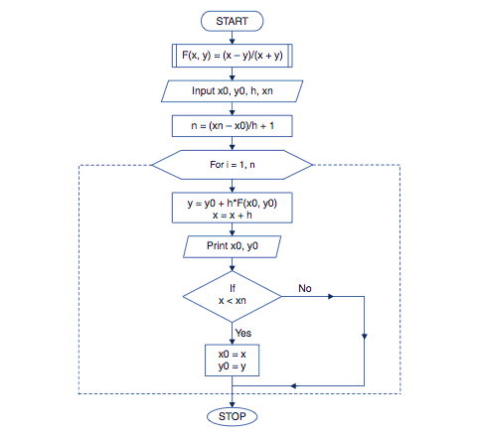
Euler Method (Flowchart)

Slide 26


